Slide 1
Introduction to cs16
CS16: Introduction to Algorithms and Data Structures
Tu/Th 10:30-11:50
Salomon DECI
Seny Kamara
Notes:
Welcome to CS16!

Slide 2
What is 16 About?
Algorithms
“a series of computer instructions to perform a given task”

Slide 3
Why Study Algorithms?
Core to Computer Science
Algs:CS is like Math:STEM
Extremely useful in practice
Age of the universe vs. seconds
Interesting and elegant ideas

Slide 4
Computer Science is Diverse
Graphics & Vision
AI
OS
Algorithms
Crypto & Security
Networking
Soft. Eng.
PL

Slide 5
Web Search in the 90’s

Slide 6
What are we learning about?
Analysis of algorithms: big-Oh, worst-case analysis, amortized analysis, expected running time
Design paradigms: dynamic programming, divide and conquer, greedy algorithms
Recursive algorithms: recurrence relations, induction
Elementary data structures: stacks, queues, trees, hash tables, binary search trees, heaps, graphs
Sorting algorithms: insertion sort, selection sort, heap sort, merge sort, quicksort, radix sort
Geometric algorithms: convex hull
Graph algorithms: depth-first search, breadth-first search, shortest path, minimum spanning tree, topological sort
Advanced topics: mapreduce, Bitcoin, PageRank, numerical algorithms

Slide 7
Welcome to CS16!

Slide 8
Outline
Meet your TAs
CS 16 Infomercial
Analyzing our First Algorithm: SeamCarving

Slide 9
Meet your TAs!

Slide 10
Goals Course Work
Learn fundamental algorithms and data structures
Find and design new ones
Reason about them
Use them
Prepare you for more CS
Lectures
10 Homeworks (30%)
4 Projects (30%)
2 Exams (25%)
Sections (10%) req’d!
In-class worksheets (5%)
Keep up with website / piazza!
Reading: Dasgupta (Optional)

Slide 11
Lectures
Cover various algorithms & data structures
How they work
Why they work
Analyze them
Activities & discussions
You are responsible for content in lecture (whether on slides or not)

Slide 12
Textbook
No required textbook
Helpful
Das Gupta, Papadimtriou and Vazirani
Goodrich and Tamassia

Slide 13
Course Page
Slides
Notes
Announcements
Helpful readings

Slide 14
Piazza
Announcements
Questions and answers
Links to helpful material (blogs, Youtube videos)

Slide 15
Office Hours
TA office hours are very helpful
Try to get unstuck on your own first
My office hours by appointment
Questions about HW or projects:
Post on Piazza
Ask in Section
TA office hours
Schedule meeting with me

Slide 16
Homeworks (30%)
10 HWs
Due every week
Python code, proofs, analysis, …

Slide 17
Projects (30%)
4 projects in Java

Slide 18
Sections (10%)
1 hour/week with 2 TAs
6-10 students
Required!
If you miss 3 you fail
Lose points for every missed section
Mini assignments
Mentor

Slide 19
Exams (25%)
Midterm (10%)
Date: March 23rd, time TBD
Final (15%)
Date: May 16th, 2PM

Slide 20
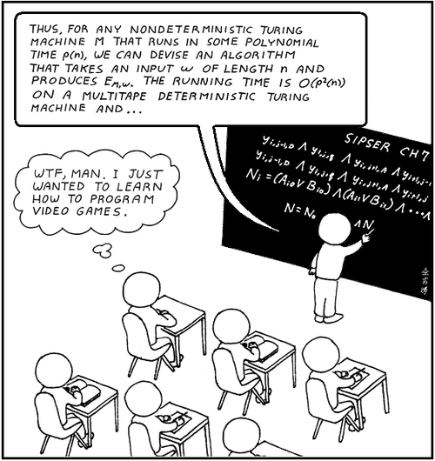

Slide 21
Collaboration
Encouraged to collaborate on HWs but
Write up HWs by yourself
Code by yourself
No sharing of code
No collaboration on Projects
You will re-write collaboration policy
We will use code similarity tester
Random live audits
“what would happen if we did X to your code?”

Slide 22
Collaboration
You’ll read and rewrite, in your own words, the collaboration policy as part of HW1
You’re highly encouraged to collaborate on homeworks, but….
One key point: no code sharing.
We’ll use an automated code-similarity tester
If you’re clever enough to beat it, you shouldn’t be in this course
We may, at random, do a “wire pull test”, i.e., ask you what your code would do if we changed some line to say something different.

Slide 23
Goals Course Work
Learn fundamental algorithms and data structures
Find and design new ones
Reason about them
Use them
Prepare you for more CS
Lectures
10 Homeworks (30%)
4 Projects (30%)
2 Exams (25%)
Sections (10%) req’d!
In-class worksheets (5%)
Keep up with website / piazza!
Reading: Dasgupta (Optional)

